Slide 1
CPS 109 - Lab 8

Slide 2
Agenda
Dictionaries
File I/O

Slide 3
Dictionaries
Most of you have probably seen dictionaries at this point, but let’s look at them in depth.
What is a dictionary? It’s an UNORDERED collection of key/value pairs.

Slide 4
Dictionaries
But what the heck is a key/value pair?
Let’s think about how a physical dictionary works. First, you look up a word and then you read its associated definition. The key is the word, the value is the definition!

Slide 5
Dictionaries
Here is the structure of a dictionary:
That’s fine and dandy, but what if we want to start with an empty dictionary?
Let’s look at an example...

Slide 6
Dictionaries
What the heck does unordered mean? And why is Cassandra emphasizing it?
Up until now, you’ve dealt with ordered collections: tuples, lists and sets. You can access data at an index. You can’t do this with dictionaries.

Slide 7
Directories
I’ve noticed some of you still aren’t familiar with how and where files are stored on your computers.
How? Why??

Slide 8
Directories
File Directory: Where your files are located, a specific directory refers to a specific folder.
Path: Refers to the internal address of a given file or folder. You generally see these at the top of the file explorer. Example:
C:\Users\Courier\Documents\Grad School\Athens Trip

Slide 9
File I/O
What is file I/O? Well, your programs don’t exist in a vacuum. You need to be able to communicate with lots of other files on your machine!

Slide 10

File I/O
How do you deal with files? First, you have to open it!
Your first argument is the file you want to open, your second is your option for dealing with the file.

Slide 11
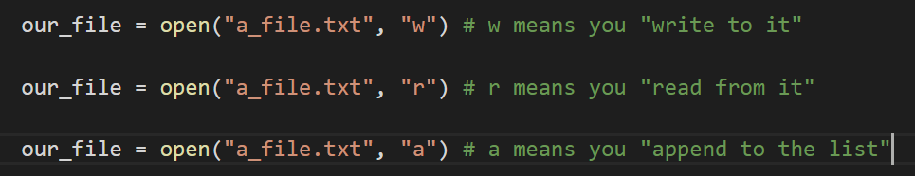
File I/O
You can do this in several ways:

Slide 12
File I/O
Now what do we do with our file? We can do lots of things! We can write to it, we can read from it, etc.

Slide 13
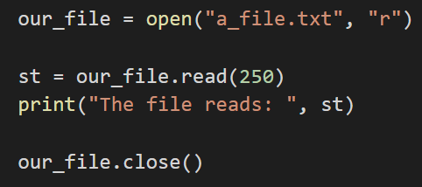
File I/O
This is a simple example of opening a file to read, then reading from it.

Slide 14
“I open at the close”
(Harry Potter rulez)
So you might be wondering, “what’s with this close nonsense? Why should I be forced to close my files? Won’t they just close when I’m done running the program?”
While the Python you’re running will be nice and close your files when you’re done, this is not a guarantee!
Notes:
PyPy, Jython, IronPython are examples of Python forks that will not handle closing nicely (as of 2015 - lol)

Slide 15
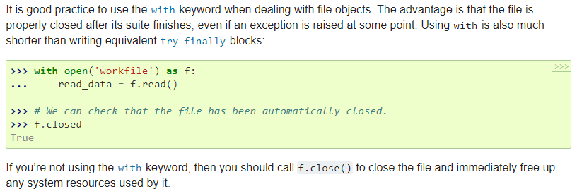
“Close encounters with the second slide”
Consider if you are running a Python program in the background, or multiple programs simultaneously. It takes resources to keep the files open. See below for best practice on how to open/close files.
Notes:
From: https://docs.python.org/3/tutorial/inputoutput.html#reading-and-writing-files

Slide 16
Questions?

Slide 17
Lab Question
In the lab 7 folder on my Github, there is a file “a_file.txt”. Download that.
Write a Python program that has a single class, DictParser. Give this class two member variables (attributes): a dictionary and an integer. Populate the dictionary with the key-value pairs from the file above, and keep track of the number of entries with the integer.
Remember: this must all be done in proper Python file format.

